Slide 1
WFZO
1

Slide 2
02
Who we are
The World Free Zones Organization (“World FZO”) is a non-profit entity operating as an association for all free zones around the world and their communities.
Established in Geneva, Switzerland and headquartered in the Dubai Airport Free Zone in United Arab Emirates.
Launched on 19th May 2014 in Dubai.

Slide 3
03
Objectives
• To bring together free zones; regional, national, sub-national and local free zone associations, consultants and advisors to free zones, free zone users, interested governmental organizations, and international trade related organizations, for the purpose of sharing of knowledge, networking, business development and education
• To gather, create, expand and disseminate the knowledge of, and about, free zones internationally
• To advocate before international organizations and governments on behalf of free zones and the collective interests of their members, and foster public awareness of free zones
• To provide valuable services to Members, Partners and Observers through physical and electronic services and resources

Slide 4
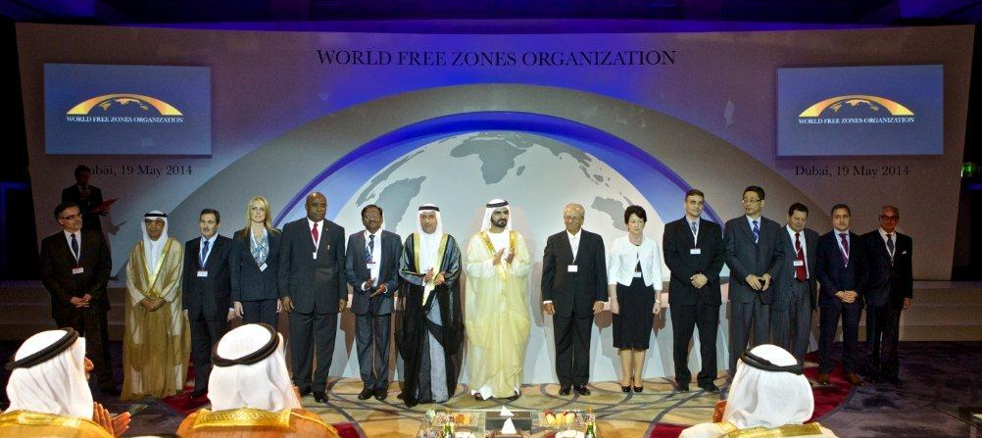
04
Our Founding Board of Directors
Dr. Mohammed Alzarooni, Chairman, UAE Pr. François Bost – Academic expert, France Ms. Julie Brown – Georgia Foreign Trade Zone, USA Mr. Kenneth Carlstedt – National Association of Foreign Trade Zones, USA Mr. Dai Haibo – China Shanghai Pilot Free Trade Zone Administration, China Mr. Isidoro Hodara – Zonamerica, Uruguay Ms. Rose Hynes – Shannon Airport& FZ Authority, Ireland |  | Mr. Martin Ibarra – Legal expert, Colombia Mr. Nasser AlMadani – Dubai Airport Free Zone, UAE Mr. PC Nambiar – EPCES, India Mr. Chris Ndibe – Africa Free Zones Association, Nigeria Mr. Luis Pellerano†– Free Zones Association of the Americas, Dominican Republic Mr. Jose Luis Rodriquez – Barcelona ZF, Spain Mr. Mehdi Tazi – Tangier Free Zone, Morocco

Slide 5
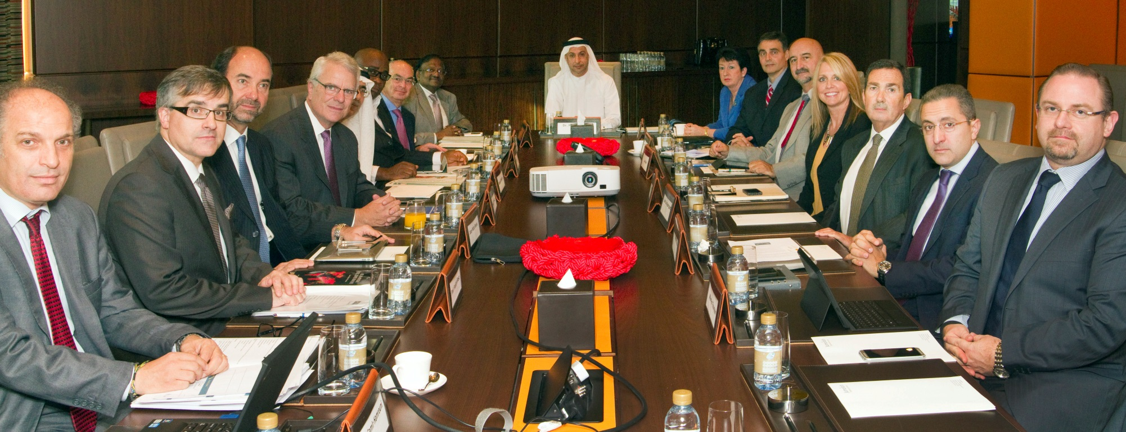
05
Meeting of the Board of Directors, CEO and Advisors
3rd November 2014
Dr. Mohammed Alzarooni, Chairman, UAE Pr. François Bost – Academic expert, France Ms. Julie Brown – Georgia Foreign Trade Zone, USA Mr. Kenneth Carlstedt – National Association of Foreign Trade Zones, USA Dr. Samir Hamrouni – CEO World Free Zones Organization Ms. Rose Hynes – Shannon Airport& FZ Authority, Ireland Mr. Martin Ibarra – Legal expert, Colombia Mr. Lewis Leibowitz – Legal expert, USA | Mr. Nasser AlMadani – Dubai Airport Free Zone, UAE Mr. PC Nambiar – EPCES, India Mr. Chris Ndibe – Africa Free Zones Association, Nigeria Mr. Juan Pablo Rivera - Free Zones Association of the Americas, Dominican Republic Mr. Jose Luis Rodriquez – Barcelona ZF, Spain Mr. Luis Sanz – Mr. Mehdi Tazi – Tangier Free Zone, Morocco Mr. Warren Thomson – Legal expert, UAE

Slide 6
06
Membership
Membership is open to:
-All nations of the United Nations.
-Individual and entities (public and private) which prove interest in the promotion and development of free zones.
-Multilateral organizations.
(a) Voting Members
(b) Associate Members
(c) Partners and Observers
Governmentally recognized free zones and/or free zone associations (local, subnational, national and regional)
Individual or corporate users of free zones, and consultants and advisors who work with, work in, or advise free zones.
Non-government organizations involved in the area of international trade and government/quasi-government authorities in trade or customs

Slide 7
07
Our Journey
AZFA Annual Conference Puerto Rico Oct 23-25 2013
Official Launch of World FZO May 19 2014
AZFA Annual Conference Panama Nov 12-14 2014
Our First Member DAFZ July 8 2014
Building our Team Management Marketing Membership and Knowledge July-Aug 2014
Steering Committee Meeting January 13-14 2014
Our 100th Member October 2014

Slide 8
08
Applications
103 MEMBERS from 30 COUNTRIES - 70 Voting | 33 Associates
Armenia Bahrain Bangladesh China Colombia
Dominican Republic Ethiopia France Guatemala
India Ireland Jordan Liberia Lithuania
From
30
COUNTRIES
Spain
Syria
Russia
Thailand
Tunisia
103
MEMBERS
Palestine
Puerto Rico
Saudi Arabia
Viet Nam
Nigeria
Morocco
Mozambique
Turkey
UAE
USA
Uruguay

Slide 9
09
Service Pillars
The Knowledge
The Network
The Support
Providing strategic insight
Providing business development and partnership opportunities
Providing Operational Support

Slide 10
10
Range of Services
The Knowledge
The Network
The Support
World FZO Observatory
FZ pedia
Open University
B2B meetings and networking events across programs
Business Directory and Marketplace
FZ Economic Outlook Events
Tenant Program
Smart Zones
Green Zones
Zones Governance

Slide 11
11
World FZO Observatory
Objective
The observatory will collect and analyze original data on the free zones in the world to assess their economic impact and advise the policy makers. It will be an access to markets research upon the request of the members to support their prospective abroad. End of the day, this observatory will be the tool of the Free Zones for their policy advocacy.
With the Observatory, we will develop three kind of output for the members:
Some Indicators, in terms of trade, FDI and incentives, to update the members of the global trends through a monthly World FZO Bulletin (in house work)
An Atlas of the Free Zones in the World, with some comparative data
The Annual Report on the Free Zones Global Trends: Free Zones Economic Outlook Report

Slide 12
12
World FZO Bulletin
The bulletin will be structured as the following:
Introduction: State of the art, review of the past trends and how they continue or change this quarter.
General overview:
Evolution of the aggregated flow of FDI in the World
Breakdown of the FDI flow per region of the World, with analysis of the increase/decrease region of origin and region of destination
The main components of FDI flow per sectors and the fast growing ones
The industry with the best jobs impact/Capex invested per regions
Regional focus:
The FDI trends in terms of industry per region and the major economies invested in the regions (intra-regional vs. inter regional FDI markets)
The FZ/SEZ trends in the different regions of the World with the same approach (industry, jobs, increase/decrease)

Slide 13
13
FZ Pedia
Objective:
The FZ Pedia will gather together the main research and analysis on the free zone/SEZ field online. It will be the first place to search for any expertise on free zones, with a scientific community participating in its development. It will act as on Online and Open Library
MediaWiki is a free software open source wiki package written in PHP, originally for use on Wikipedia. It is now also used by several other projects of the non-profitWikimedia Foundation and by many other wikis, including this website, the home of MediaWiki.

Slide 14
14
Open University
Objective:
The Open University of World FZO will act as the One-Stop-Shop in regards with Education, Research and Training of Free Zones. It will gather together all the main online productions for capacity building and Best practices sharing relevant to the Free Zones context, from our main Strategic partners such as the World Bank, the UNCTAD, the UNIDO, the OECD, and so.
The World FZO will produce its own training and education activities.

Slide 15
15
Range of Services
The Knowledge
The Network
The Support
World FZO Observatory
FZ pedia
Open University
B2B meetings and networking events across programs
Business Directory and Marketplace
FZ Economic Outlook Events
Tenant Program
Smart Zones
Green Zones
Zones Governance

Slide 16
16
The Network
Business Directory / Marketplace
Online Platform
Events

Slide 17
17
Business Directory/Marketplace
Objective:
An online Business Directory/Marketplace available on the World FZO website, where members can include their contact details and information about their business and login to find another member per sector and region. Membership/Network facilitation.
The target is to create business opportunities and network between all the members, with some specific skills from the associate members to be used by the full members upon their request.

Slide 18
18
World FZO Online Platform
A B2B interactive database:
A centralized directory that helps companies search, find and connect to businesses around the world, instantly and for free
A “one stop shop” for companies everywhere:
A service to keep in touch with each other over time and across distances, effortlessly
A go--‐to industry newsfeed:
An up to the minute channel fed by company posts that can be filtered by region and sector (i.e. acquisitions, procurement awards, etc.)
A learning experience:
A tool for business organizations, chambers and educational institutions to connect with each other internationally and fuel their interests

Slide 19
19
World FZO Online Platform
Creating a B2B community within a global ecosystem
BeConnections provides World Free Zones Organization members and associates with a platform to engage with companies and organizations on all levels of the exporting and business lifecycles
World Free Zones Organization
FTZ Members
Industry Groups and Chambers
Other Companies
Government Agencies
FTZ Associates

Slide 20
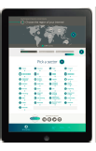
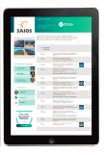
20
World FZO Online Platform
4 steps that will make a difference
Whereas Facebook and LinkedIn connect people and professionals, BeConnections™ connects companies to other businesses around the world, instantly. Use our to search engine and find local partners & Suppliers anywhere; navigate through the global marketplace; and keep in touch with the companies that matter to your business effortlessly.
Registration is free, quick and easy.
Our interactive database categorizes businesses into regions and industries helping users to explore markets formerly beyond their reach and target local partners. Use the filters to find new connections.
Select a business from the results and connect instantly.
Company profiles include contact information, company posts, links to its website and social networks, photos, an optional employee pyramid and a messaging service, tied to the administrator’s email account.

Slide 21
21
World FZO Online Platform
World FZO Associates & Members can:
Develop and maintain relationships with companies – not people
Search, find and connect with local partners & suppliers within the global B2B ecosystem
Follow industry and market trends all in one place
Newsfeeds are fueled by company posts that can be filtered by region and/or sector = read only what matters to your business
Join and promote B2B events (forthcoming)
Find and be found on the interactive database
Keep in touch with members of World FZO and with business outside of this community, effortlessly
Create a hub for their connections to grow on, over time and across distances
Get detailed reports on which markets to export or expand into – we can also circulate reports conducted by Free Zones or their members
Be featured twice a month in our “business trends” blog
Use the interactive events calendar to identify networking opportunities – sign up to that forum and connect with participating companies before and after it
List themselves in the global database and be directly contacted by new business prospects or use it to move or open new locations
World FZO can promote its activities free of cost, in the region and sector of its commercial interest
Connect with other World FZO members

Slide 22
22
FZ Economic Outlook Events
Objective:
To gather together the different actors interested in free zones to discuss together the global economic trends of free zones.
Will speak further on this later in the presentation.

Slide 23
23
Range of Services
The Knowledge
The Network
The Support
World FZO Observatory
FZ pedia
Open University
B2B meetings and networking events across programs
Business Directory and Marketplace
FZ Economic Outlook Events
Tenant Program
Smart Zones
Green Zones
Zones Governance

Slide 24
24
Support
Free Zone
One Stop Shop
Smart Zones
Green Zones
Zones Governance
Tenant
Tenant Development Program
Employee
Open University
Leadership
Innovation
International Trade
Green Job
Job Place Quality

Slide 25
25
OSS - Modules
System is divided into the following functional modules :
Sales
Lease & Licensing
Commercial Services
Security & Compliance
IT Services
Facilities Management Services
Invoicing & Payment

Slide 26
26
OSS - Modules
Sales
Lease & Licensing
Commercial Services
Security & Compliance
Sales Inquiries
Online Application
Office Allocation
Company Evaluation
Company Registration
Lease Mgmt: New/ Expand/Reduce/Transfer
Trade License: New/Renew/Amend
Work Permits
Registration with Chambers, Customs etc.
Employee Visas
Dependent Visas
Letters/Certificates
Employees Insurance
Customer Care (Complain Mgmt)
Parking Mgmt
Gate Passes
Car Stickers
Incident Reporting
Inspection

Slide 27
27
OSS - Modules
IT Services
Facilities Management Services
Invoicing & Payment
Telecommunication Services (Phone/Fax/Internet)
IT Support & Consultancy
Property Key Management
Property & Parking Signages
Property Renovation
Office Maintenance
Property Fit-out
Monthly Billing
Online Statements/ Commercial Bills/ Telephone Bills
Online Payment

Slide 28
28
OSS – @ Your Site
At Organizations (Setup Requirements) |  | On Cloud
Hardware | 2 Servers | Study to be prepared
Operating System | MS Windows 2008
Database | SQL Server 2012
Setup time | 3 – 4 Months
Internet Connection: 2 MBps

Slide 29
29
Green Zones - Opportunities and Synergies
Objective:
The Green Zone service will aim to promote Green Policy towards the Free Zones and their tenants. The World FZO will act as a policy advocacy of the Green Policy and will promote to the stakeholders a package of tools developed by its partners. These tools will be composed of Green Performance and Efficiency Indicators, Green Certification, a portfolio of best practices and capacity buildings sessions.
A portfolio of best practices that can be rolled out internationally to fulfill the creation of a Green Sectorial Baseline for Free Zones.
APPs and databases for self assessments
Tools for Performance and efficiency
Green Certification and Maturity models
Knowledge Management
Programmes, tools and activities here suggested are based on subnational, national, regional and global strategies implemented and rated in conjunction with UN and Bretton Wood organizations.

Slide 30
30
Green Zones - Green Certification and Maturity
Based on international best practices, Green PMO maturity and ISO standards.
Green FZO
OPTIMISED
Level 5
Portfolio
Programme
Project
MANAGED
Level 4
DEFINED
Level 3
Management Control | Benefits Management | Finance Management | Stakeholder Management | Risk Management | Organisation Governance | Resources Management
REPEATABLE
Level 2
Process Perspectives
AWARE
Level 1
Planning - Skills and Capability - Assurance - Information Management

Slide 31
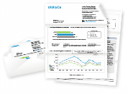
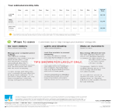
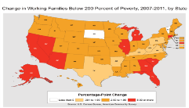
31
Green Zones - APPs and web-based tools
Smart-city as an enabler to Smart-FZO
Allow users
to collect necessary
data for
benchmarking and analysis
Online self-assessment tools
Aggregated statistics and benchmarking
SMS and Mobile analytical tools
Systems Integration
Cascading tools for FZ tenants
Regional specific programme
Multilingual

Slide 32
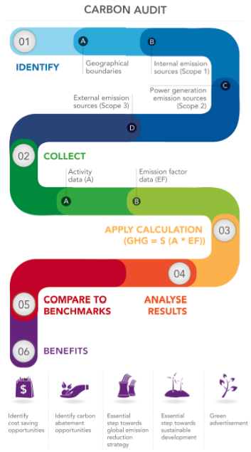
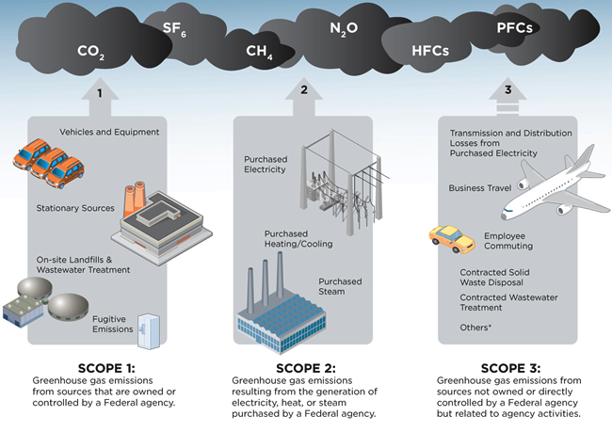
32
Green Zones - Resource and Carbon Emissions Audit
Stress-testing strategies and processes against global trends and opportunities
Direct Emissions
Indirect Emissions
Leakages
Fuel from vehicles
Fuel from generators
Purchased power, cooling, water
Travel (air and land)
Waste
Contracted Services (ie. transport)
Fuel from furnaces or heating

Slide 33
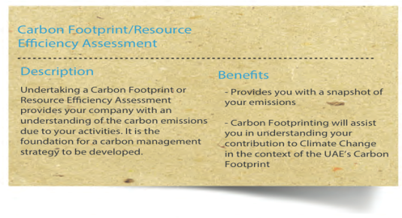
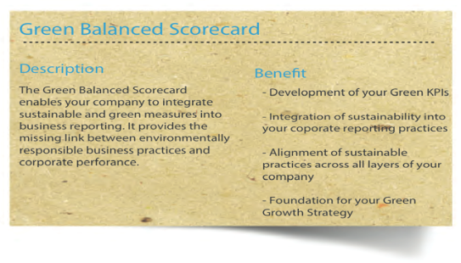
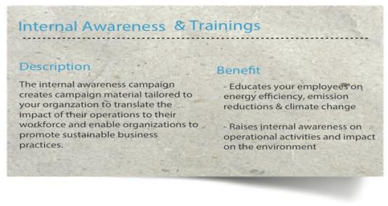
33
Green Zones - Training and Tools
Harmonizing sustainability through Green Score Cards

Slide 34
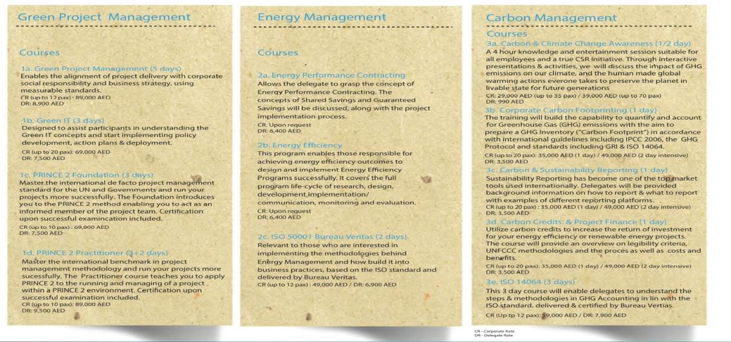
34
Green Zones - Capacity Building
Operational Knowledge and most relevant standards

Slide 35
35
Green Zones - Green Finance
Leveraging Public Private Partnerships (PPPs) to implement
Creating a market for Green Bonds, reducing Capital Costs and increasing access and availability to liquidity markets
A PPP is a contractual agreement between a public agency and a private sector entity.
The assets and skills of each party are shared in delivering a facility.
The risks and rewards of the delivery are shared and generate sustainable economic growth

Slide 36
36
Zones Governance
Objective:
To support the management and governance within the free zones through a tailored and dedicated following program.
Free Zone ISO
Safe Zone

Slide 37
37
Tenant Development Program
Develop a Tenant development program (over 500 business learning videos) hosted on the WFZO portal.
 | Topics | Session Objective
1 | Strategy | What is your business about?
2 | Innovation | How can you extend your business?
3 | Leadership | What does it take to lead your company?
4 | Talent development | How do you engage your most important asset?
5 | Brand & Marketing | How do you communicate it?
6 | ICT, Web & Social media | How do you increase efficiency?
7 | Sales | How do you sell it?
8 | Legal | How do you protect your assets?
9 | Finance for SMEs | How do you make your money work more for you?
10 | Project management | How do you implement it efficiently?
11 | Expansion | What are the growth options for you?
12 | Funding and Investment | What is the best source of funding for your business?

Slide 38
38
Service Pillars
The Knowledge
The Network
The Support
World FZO Observatory
FZ pedia
Open University
Bulletin
Annual Report
Atlas
B2B meetings and Networking events
Business Directory
Marketplace
FZ Economic Outlook Events
Tenant Program
Smart Zones
Green Zones
Zones Governance

Slide 39
We are pleased to announce The First Annual Conference and Exhibition 11-13 May 2015 Dubai, UAE

